Slide 1



Honours Minor Degree Program and Language Certificate in Japanese Studies
2025 -2026 Edition
Japanese Studies Program
Department of Languages, Literatures and Linguistics

Slide 2
Japanese Studies Program @ York University
Japanese Studies Program at York University offers Japanese language courses for all levels as well as courses on Japanese culture and linguistics. The program takes advantage of Technology Enhanced Learning (TEL) to enhance teaching and learning. It emphasizes students’ acquisition of socio-cultural knowledge for successful cross-cultural communication with Japanese.
Study Abroad in Japan at Meiji, Dokkyo, Hitotsubashi, Keio, and Waseda Universities (Tokyo area); Nagoya University (Central Japan area); or Aoyama Gakuin University (suburban Tokyo).
Certificate of Language Proficiency
Other opportunities: Japanese Language Proficiency Test (JLPT), Ontario and National Japanese speech contests, JET Program, graduate school, and more.

Slide 3
Faculty members
Prof. Norio Ota
Prof. Noriko Yabuki-Soh
(on sabbatical leave)
Prof. Kumiko Inutsuka
Prof. Cary Takagaki
Prof. Akiko Mitsui
Prof. Eri Takahashi

Slide 4
Certificate of Proficiency in Japanese Language
York University students may earn a Certificate of Proficiency in Japanese Language concurrent with fulfillment of the requirements for a bachelor's degree.
This certificate is not open to students who are pursuing or who already hold a degree in Japanese Studies.
Requirements (total 18 credits):
  Passed AP/JP1000 6.0 and AP/JP2000 6.0
  Earned a minimum grade of B+ in AP/JP3000 6.0

Slide 5
Honours Minor Degree Program in Japanese
Commenced in September 2014
Honours Minor BA: A minimum of 36 credits
The Honours Minor in Japanese Studies may be combined with any approved Honours B.A. program that offers a major/minor option in the Faculties of Environmental Studies (Bachelor of Environmental Studies - BES), Health, Liberal Arts and Professional Studies, Fine Arts or Science and Engineering. For further details on requirements, refer to the listings for specific Honours programs that may be pursued jointly with other Faculties.
Note: in a major/minor program, a course may count only once toward major credit or minor credit.

Slide 6
Minor credits
A minimum of 36 credits in the minor, including at least 6 credits at the 4000 level.
36 credits including:
  (i) Japanese Studies Core: 24 credits (compulsory):
  AP/JP1000, AP/JP2000, AP/JP2700, AP/JP3000
  (ii) 12 additional credits at the 3000- or 4000-level chosen from:
    AP/JP3070, AP/JP3100, AP/JP3200, AP/JP3600, AP/JP3610, AP/JP3620, AP/JP3751, AP/JP3900, AP/JP4000, AP/JP4900
Note: Students exempt from AP/JP 1000 6.00, AP/JP 2000 6.00 or AP/JP 3000 6.00 must take AP/JP 4000 6.00 and additional 4000-level courses as well as the above 12 credits.

Slide 7
Program
Checklist

Slide 8
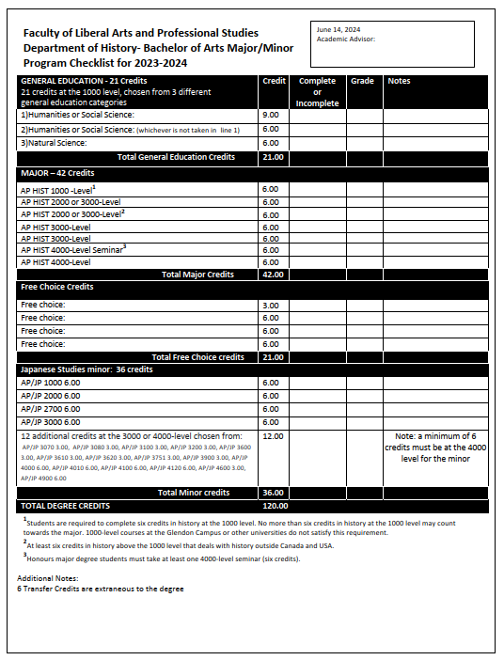
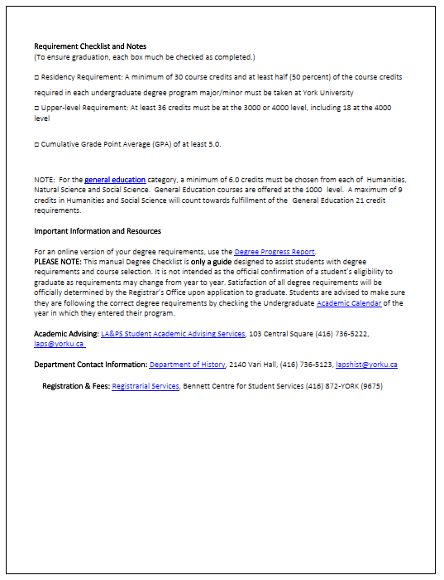
Sample
Program
Checklist
Comment from a student majoring in History and minoring in Japanese Studies:
“My academic advisor tailor-made the document for my specific major and minor combination, taking into account completed courses and credits up until then. I am pretty sure that they will do the same for any of the prospective minor program students that end up specifically asking for one.”

Slide 9
East Asian Studies Credits
Honours BA Program
Students will take at least 42 credits in East Asian Studies, including at least one core course and at least 12 credits (other than language/translation courses) at the 4000-level. Demonstrated competence in an East Asian language (Chinese or Japanese or Korean) at the intermediate level is required. This requirement would normally be met by successful completion of AP/CH 2000 6.0 or AP/JP 2000 6.0 or AP/KOR 2000 6.0. It may also be met by passing a competency test, or by successful completion of another course recognized for the purpose.
Upper Level Credits: at least 36 credits at the 3000-level or 4000-level, including at least 18 credits at the 4000-level. JP4000 is accepted as a 4000-level required course for the major.
Credits earned in the Japanese language courses cannot be used for both EAS major and JP minor.
Credits Outside the Major: at least 18 credits. Note: students who are completing a double major or major/minor are deemed to have fulfilled this requirement. EAS

Slide 10
Language courses & Core course
Course | Title | Credit
AP/JP1000 | Elementary Modern Standard Japanese | 6.0
AP/JP2000 | Intermediate Modern Standard Japanese | 6.0
AP/JP3000 | Advanced Modern Standard Japanese | 6.0
AP/JP4000 | Post-Advanced Modern Standard Japanese | 6.0
AP/JP2700 | Contemporary Japanese Culture and Society | 6.0

Slide 11
Non-language courses in Japanese Studies: 3000 level
Course | Title | Credit
AP/JP3070 | Japanese Language in the Media | 3.0
AP/JP3080 | Food, Foodways, and the Japanese Language: A Linguistic Perspective | 3.0
AP/JP3100 | Japanese Linguistics I: Structure of Modern Japanese Language | 3.0
AP/JP3200 | Japanese Linguistics II: Structure of Modern Japanese Language | 3.0
AP/JP3600 | Japanese Popular Culture: manga and anime | 3.0
AP/JP3610 | Japanese Popular Culture: beyond manga and anime | 3.0
AP/JP3751 | Japanese Business Culture and Communication | 3.0

Slide 12
Non-language courses in Japanese Studies: 4000 level
Course | Title | Credit
AP/JP4010 | Classical Japanese | 6.0
AP/JP4100 | Teaching of Japanese as a Foreign/Second Language | 6.0
AP/JP4120 | Translation: Japanese - English; English – Japanese | 6.0
AP/JP4600 | The Japanese Immigration Experience in Canada | 3.0
AP/JP4900 | Independent Reading and Research | 6.0

Slide 13
How to declare JP Honours Minor Degree
Those who wish to minor in Japanese Studies should visit this site: https://myacademicrecord.students.yorku.ca/program-change (or alternatively go to the ‘Current Students’ page on the yorku.ca website, click ‘Registrar’s Office,’ and choose ‘Program Change’ under ‘Menu’)
Then, go to ‘Step 4. Program Change Request’ and click on the ‘Program Change Request’ icon and log into your Yorku account.
Once you are logged in, click on ‘Program Change’. Then select your program from the drop-down boxes, making sure to choose ‘Honours-Major/Minor’ for the ‘Program Type’ section and ‘JPST - Japanese Studies’ for the ‘Double Major/Minor' section.
**If you are majoring in the sciences, you may not find Japanese Studies listed as a possible minor option. So, you will then need to click on the “I cannot find my program” link near the bottom. Once you do, you will need to manually type in your Major, and then type in “Japanese Studies” in the Double Major/Minor box.
After that, check the box under ‘Confirmation’ and click ‘Submit Request’. It will take about a month for your program change request to be confirmed.

Slide 14
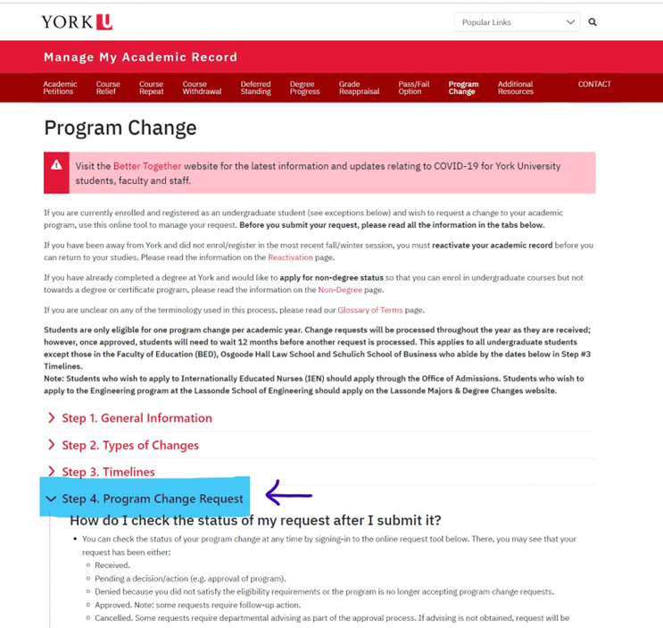
How to declare JP Honours Minor Degree
There is a dropdown menu and it only contains
combinations that have been selected previously.
If the particular combination of your major with
a Japanese studies minor has not been chosen
before, it will not come up. There is an option to
manually indicate it, and that is the option you
must choose. If it is not listed, you will have to
create it for the first time--type in "Japanese
studies." That is all!! If you still run into a trouble,
you should seek help from an Advisor in 103 Central
Square or the Registrar's Office.

Slide 15
Majors and Minors
Japanese Studies @ DLLL Website: https://www.yorku.ca/laps/dlll/jp/
https://futurestudents.yorku.ca/majors-minors
This link may be helpful in what programs can and cannot be applied to the Japanese Minor Program.
https://www.yorku.ca/laps/dlll/jp/degree-options-requirements/
This link gives you an overview of Honours Minor (BA) and Language Proficiency Certificate in Japanese

Slide 16







Exchange Programs
Study Abroad in Japan at:
Meiji
Dokkyo
Hitotsubashi
Keio
Waseda Universities (Tokyo area)
Nagoya University (Central Japan area)
Aoyama-Gakuin University (suburban Tokyo)
For inquiries about exchange programs, contact York International:
https://yorkinternational.yorku.ca/contact-us/

Slide 17
Ontario and National Japanese Speech Contests
OJSC: First Saturday of March
NJSC: Last Saturday or Sunday of March
Participants from York are chosen after an internal screening
York students have been winning top prizes at OJSC/NJSC
For general information and past winners’ speeches, etc., visit: https://buna.yorku.ca/ojsc/
Y-File articles:
  York Students sweep Ontario Japanese Speech Contest - YFile (Mar 2025)
  Students continue to win big at national Japanese speech contest - YFile (Apr 2024)

Slide 18

JET Programme Orientation Session
In-person/Online info session run by Marcia Iwasaki, Consulate General of Japan staff and JP Program
• Recording available: Go to your JP eClass

Slide 19
For further information:
Please visit the Japanese Studies Program @ York University website. URL: https://buna.yorku.ca/
Please contact us about the Program:
Norio Ota/Noriko Yabuki-Soh
email: nota@yorku.ca/nyabuki@yorku.ca

